Slide 1
Advanced Predictive Analytics System Data Visualization Presentation

Slide 2
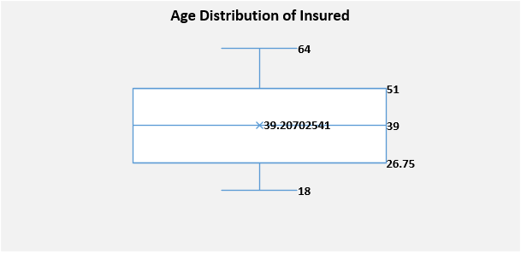
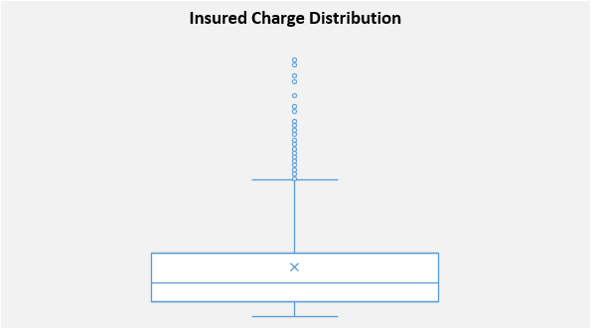
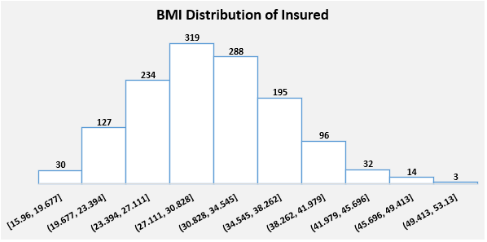
Summary Statistics and Distributions
$34,617.84
$16,687.36
$9,382.03
$1,121.87
$4,733.64

Slide 3
Correlation Analysis

Slide 4
Charges Analysis Across Different Categories

Slide 5
Charges Analysis Across Different Categories

